Slide 1
Chapter 1 Introduction to the World of Technology

Slide 2
Learning Objectives (1)
Explain why it is essential to learn about computers today and discuss several ways computers are integrated into our business and personal lives.
Define a computer and describe its primary operations.
List some important milestones in computer evolution.
Identify the major parts of a personal computer, including input, processing, output, storage, and communications hardware.
Define software and understand how it is used to instruct the computer what to do.
2

Slide 3
Learning Objectives (2)
List the six basic types of computers, giving at least one example of each type of computer and stating what that computer might be used for.
Explain what a network, the Internet, and the World Wide Web are, as well as how computers, people, and Web pages are identified on the Internet.
Describe how to access a Web page and navigate through a Web site.
Discuss the societal impact of computers, including some benefits and risks related to their prominence in our society.

Slide 4
Overview
This chapter covers:
What computers are, how they work, and how they are used
Computer terminology
An overview of the history of computers
The basic types of computers in use today
How to access resources on the Internet
The societal impact of computers
4

Slide 5
Why Learn About Computers and Technology?
Pervasive computing
Also known as ubiquitous computing
Computers are everywhere and have become an integral part of our lives
Before 1980
Computers were large and expensive
Very few people had access to them
Computers were mostly used for high-volume processing tasks

Slide 6
Early Personal Computer Use
Early 1980s
Microcomputers (inexpensive personal computers) were invented
Dramatic increase in computer use
Early 1990s
The World Wide Web (WWW) and the graphical Web browser were invented
Increased the purchase and use of computers for personal use

Slide 7
Computers and Technology Today
Most U.S. households have a computer or smartphone, and most individuals use a computer device at work
Electronic devices are converging into single units with multiple capabilities, such as to:
Check e-mail on living room television
Make telephone calls via a computer
View Internet content on a smartphone
Computer literacy (understanding what a computer is and how it works) is an essential skill for everyone

Slide 8
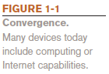
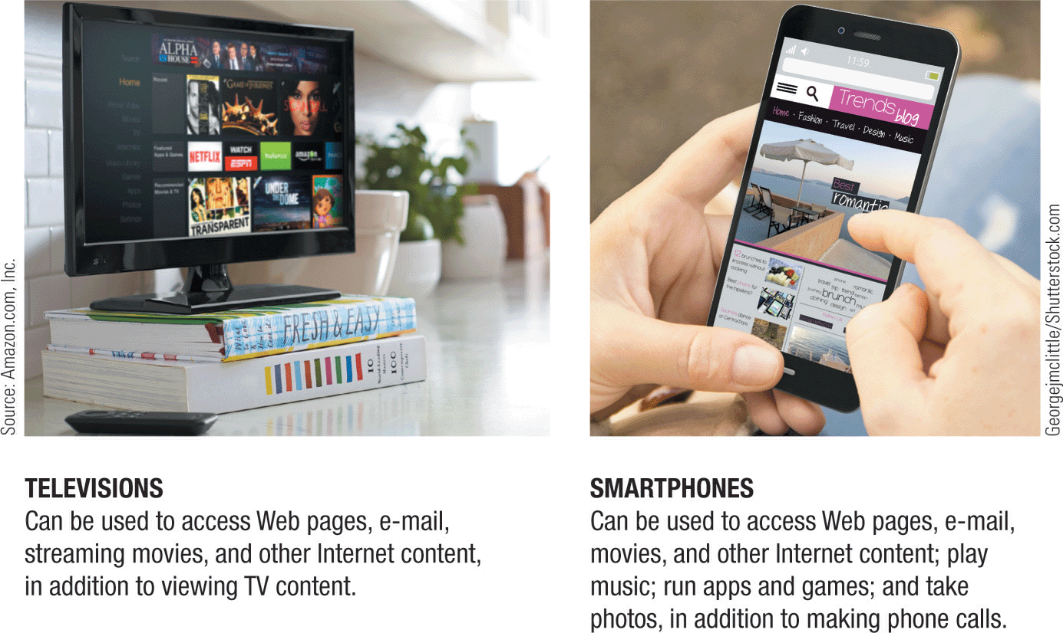
Convergence

Slide 9
Computing Devices in the Home
Computers are used for a variety of tasks:
Looking up information and news
Exchanging e-mail
Shopping and paying bills
Watching TV, videos, and movies
Downloading music and movies
Organizing digital photographs
Playing games
Making vacation plans
Other reference, productivity, or entertainment tasks

Slide 10
Computing Devices in the Home (cont’d)
Common technologies
Wireless networking
Computers can be used in nearly any location
Smart appliances
Traditional appliances with built-in computer or communication technology
Smart homes
Household tasks are monitored and controlled by a main computer in the house or a smartphone

Slide 11
Computing Devices in Education
Most children and teens have used computers all their lives
Computer labs and classrooms
Most students today have access to computers at school
Some schools integrate e-books into the curriculum
Some schools supply or require a device
Wireless hotspots
Allow students to access the Internet and campus resources
Distance learning
Students participate from locations other than the traditional classroom setting using computers and Internet access

Slide 12
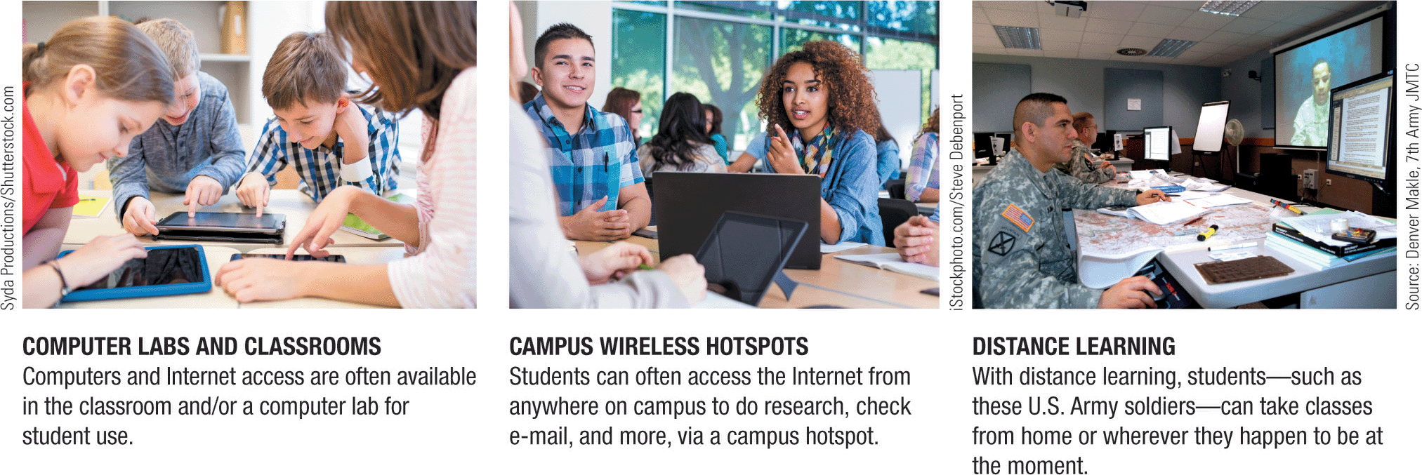
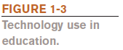
Examples of Computing Devices in Education

Slide 13
Computing Devices on the Job
Computers have become a universal on-the-job tool
Used by all types of employees
Used for decision-making, productivity, and communications
Used for access control and other security measures
Used by service professionals
Used extensively by the military
Often requires periodically updating computer skills
Some jobs exist because computers exist

Slide 14
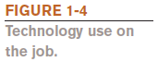
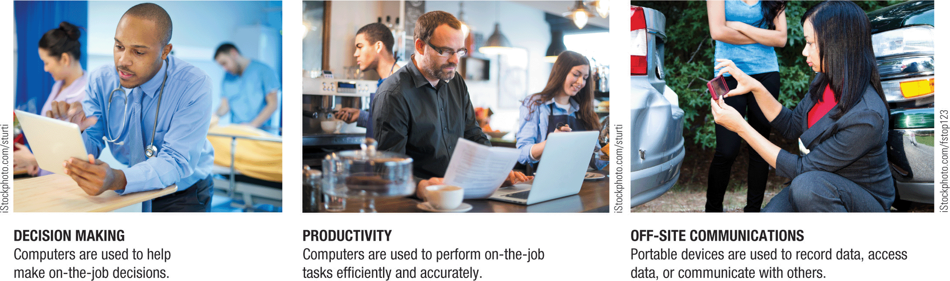
Examples of Computing Devices on the Job

Slide 15
Computing Devices on the Go
Computers are encountered in nearly every aspect of daily life
Consumer kiosks
ATM transactions
POS systems at retail stores
Self-checkout systems
Consumer authentication systems
Portable computers
Smartphones and smart watches
GPS systems

Slide 16
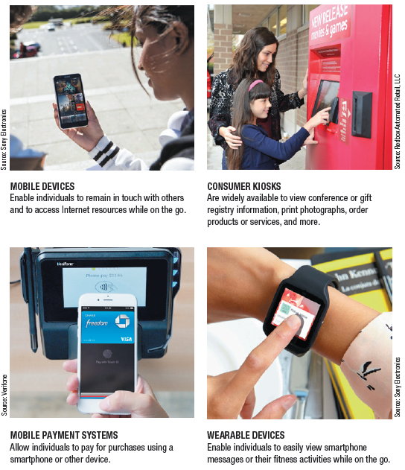
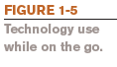
Examples of Computing Devices on the Go

Slide 17
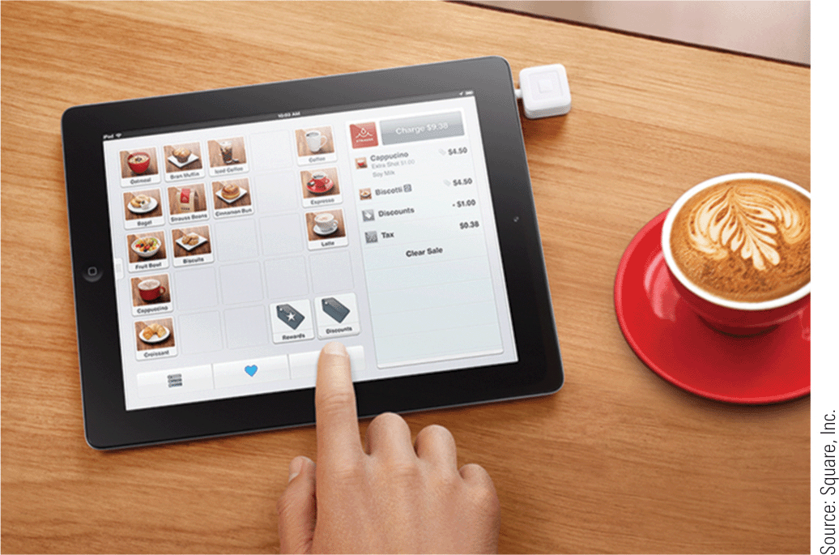
Technology and You
Restaurant iPad Ordering Systems
Used in conjunction with e-menus
Customers can place and pay for orders
Can provide more resources to customers
Restaurant iPad ordering system.

Slide 18
What Is a Computer and What Does It Do?
A computer is a programmable, electronic device that accepts data, performs operations on that data, and stores the data
Its instructions, called programs, determine the tasks the computer will perform
Basic operations (the IPOS cycle)
Input: Entering data into the computer
Processing: Performing operations on the data
Output: Presenting the results
Storage: Saving data, programs, or output for future use
Communications: Sending or receiving data

Slide 19
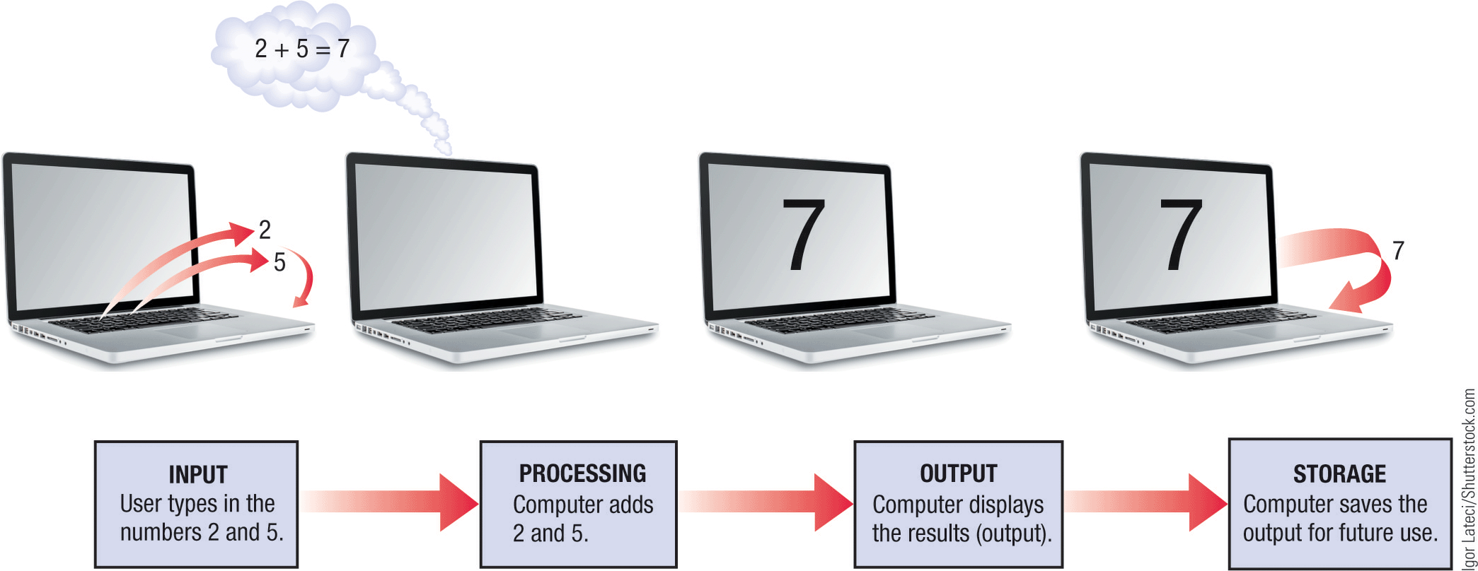
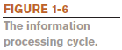
The IPOS Cycle

Slide 20
Data vs. Information
Data is raw, unorganized facts
Can be in the form of text, graphics, audio, or video
Information is data that has been processed into a meaningful form
Information processing is the conversion of data into information

Slide 21
Computers Then and Now: Precomputers and Early Computers
The computer as we know it is a fairly recent invention
The history of computers is often referred to in terms of generations
Each new generation is characterized by a major technological development
Precomputers and early computers (before approx. 1946)
Abacus, slide rule, mechanical calculator
Punch Card Tabulating Machine and Sorter

Slide 22
Computers Then and Now: First and Second Generation Computers
First-generation computers (1946-1957)
Enormous and powered by vacuum tubes
Used a great deal of electricity and generated a lot of heat
ENIAC and UNIVAC
Second-generation computers (1958-1963)
Used transistors
Computers were smaller, more powerful, cheaper, more energy-efficient, and more reliable
Punch cards and magnetic tape were used for input
Punch cards and paper were used for output
Magnetic tape was used for storage

Slide 23
Computers Then and Now: Third and Fourth Generation Computers
Third-generation computers (approximately 1964–1970)
Used integrated circuits (ICs), which consist of transistors and electronic circuits on a single tiny silicon chip
Keyboards were used for input; monitors for output
Hard drives were used for storage
Fourth-generation computers (approximately 1971–present)
Use microprocessors, which contain the core processing of an entire computer on a single chip
Keyboards and mice are used for input; monitors and printers for output; hard drives, flash memory media, and optical discs for storage
Networks and the Internet were developed

Slide 24
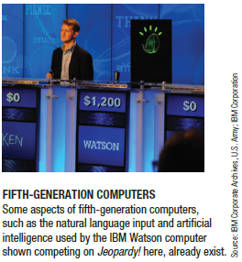
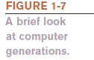
Computers Then and Now: Fifth Generation Computers
Fifth-generation (now and the future)
Most commonly defined as being based on artificial intelligence (AI)
Some aspects like voice and touch input are used today
Future computers may be different, such as:
Optical computers
Tiny computers that utilize nanotechnology
General-purpose computers built into everyday devices

Slide 25
Hardware
Hardware is the physical parts of a computer
Internal hardware
Located inside the main box (system unit) of the computer
External hardware
Located outside the system unit
Connect to the computer via a wired or wireless connection
Hardware devices are associated with all five computer operations

Slide 26
Input, Processing and Output Devices
Input devices
Used to input data into the computer
Include keyboards, mice, scanners, cameras, microphones, pens, touch pads, touch screens, fingerprint readers, etc.
Processing devices
Includes the central processing unit (CPU), which performs calculations and controls the computer’s operation
Also includes additional processors, such as the graphics processing unit (GPU), and memory
Output devices
Present results to the user
Includes monitors, printers, speakers, headphones, etc.

Slide 27
Storage and Communications Devices
Storage devices
Used to store data on or access data from storage media
Include hard drives, CD/DVD discs and drives, USB flash drives, etc.
Communications devices
Allow users to communicate with others and to electronically access remote information
Includes modems, network adapters, routers, etc.

Slide 28
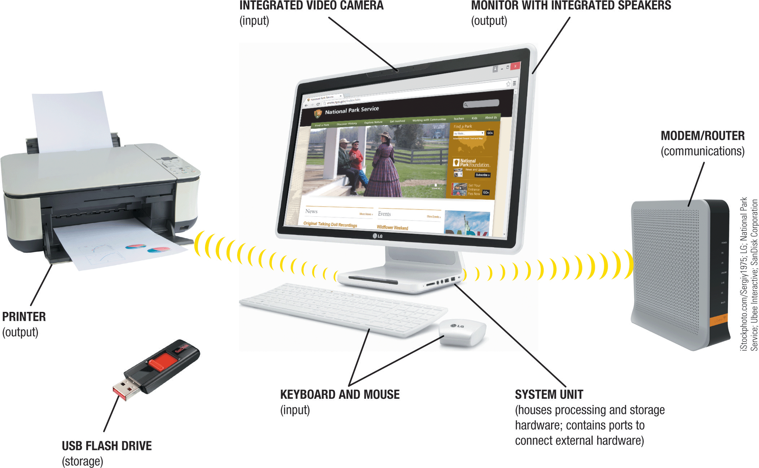
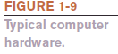
Examples of Hardware

Slide 29
Software
Software is the program or instructions used to tell the computer hardware what to do
System software allows the computer to operate
Includes the operating system, which starts up the computer and controls its operation
Without an operating system, a computer cannot function
The operating system boots the computer and launches programs at the user’s direction
Most use graphical objects to interact with the user via icons, buttons, tiles, etc.
Includes Windows, OS X, Linux, Android, iOS, etc.
The Windows desktop is the work area for Windows PCs

Slide 30
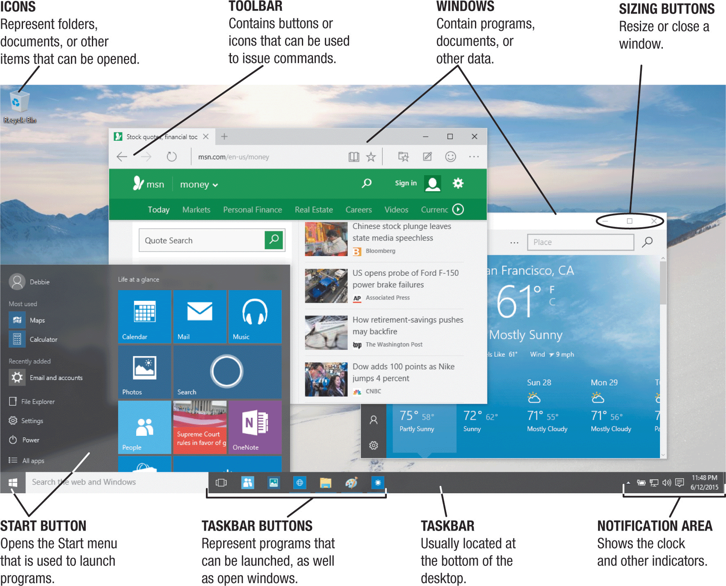
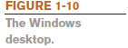
The Windows Desktop

Slide 31
Application Software (Apps)
Application software (apps) perform specific tasks or applications
Creating letters, budgets, etc.
Managing inventory and customer databases
Editing photographs
Scheduling appointments
Viewing Web pages
Exchanging e-mail
Burning DVDs
Designing homes
Playing games, watching videos, listening to music
Writing computer programs and creating Web pages

Slide 32
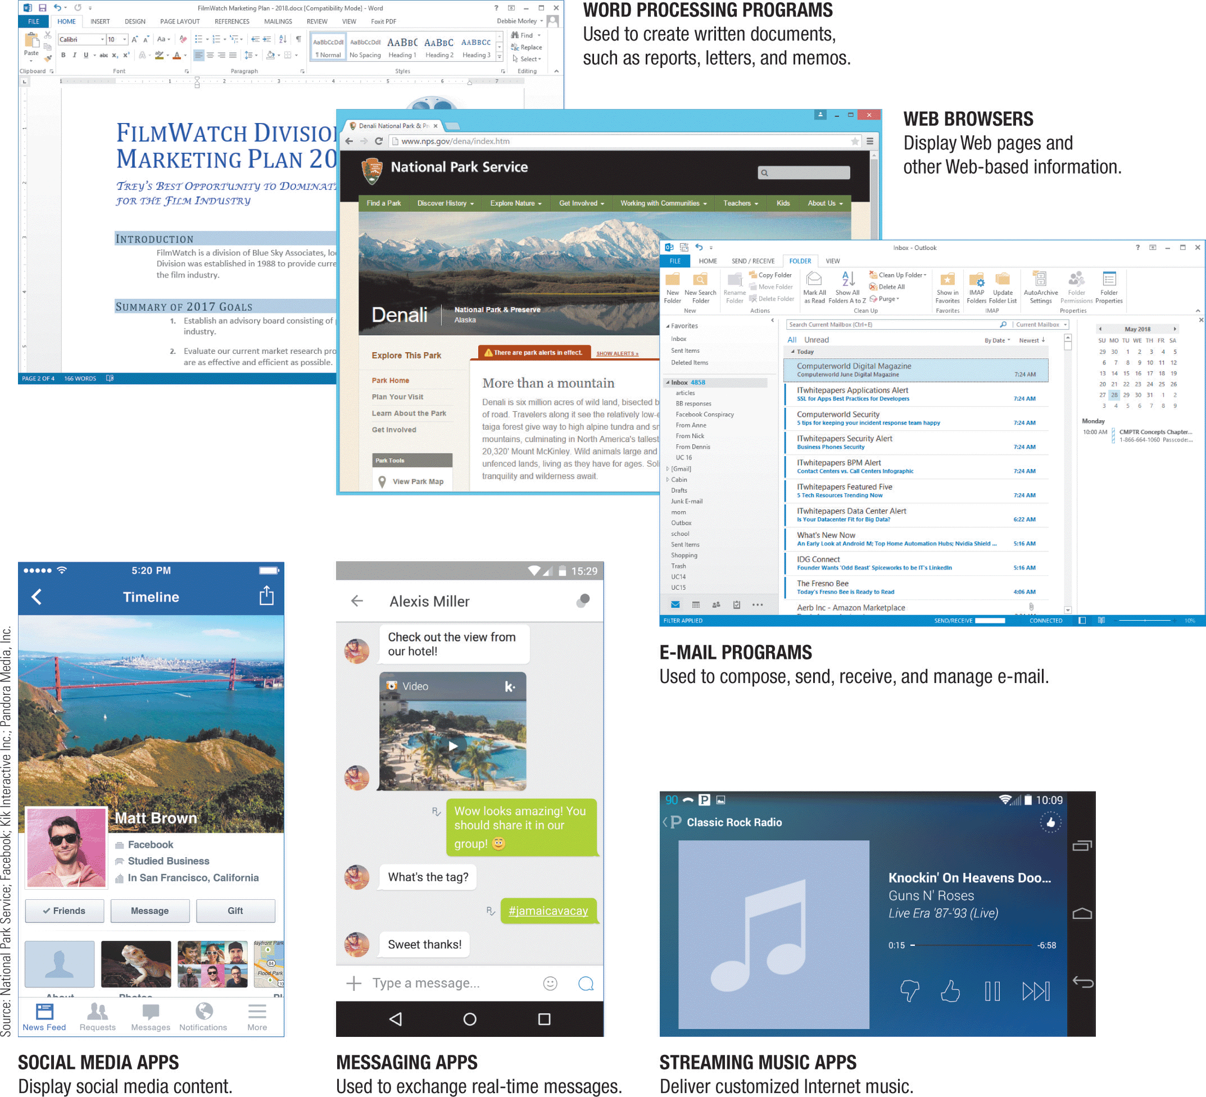
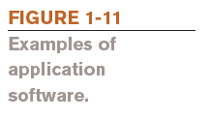
Examples of Application Software

Slide 33
Computer Users and Professionals
Computer users (end users) use a computer to perform tasks or to obtain information
Computer professionals include:
Programmers
Write programs that computers use
Systems analysts
Design computer systems
Computer operations personnel
Manage day-to-day computer operations
Security specialists
Secure computers and networks against hackers

Slide 34
Quick Quiz (1)
1. Which of the following was not a first generation computer?
a. IBM PC
b. UNIVAC
c. ENIAC
2. True or False: Microsoft Windows is an example of an operating system.
3. Speakers are an example of a(n) _____________ device.

Slide 35
Quick Quiz (1)
Answers:
a;
True;
output

Slide 36
Computers To Fit Every Need
Six basic categories of computers:
Embedded computers
Mobile devices
Personal computers
Servers
Mainframe computers
Supercomputers

Slide 37
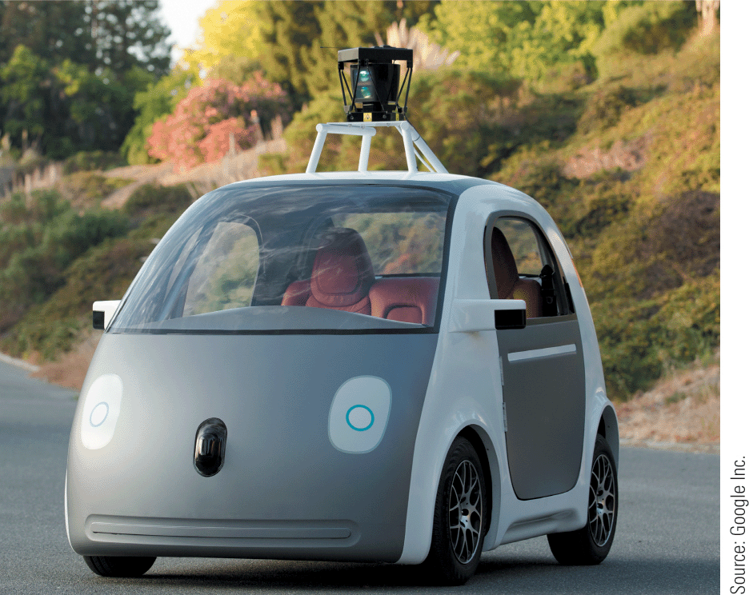
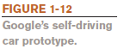
Embedded Computers
An embedded computer is designed to perform specific tasks or functions for the product in which it is embedded
Household appliances
Thermostats
Sewing machines
Treadmills
Answering machines
Cars
Self-driving cars

Slide 38
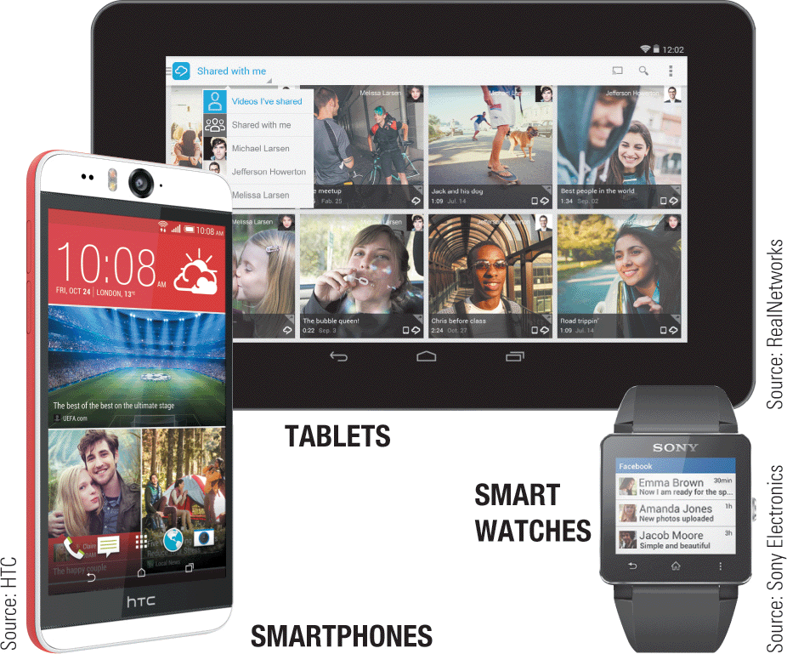

Mobile Devices
A mobile device is a very small device with some type of built-in computing or Internet capability
Typically has a small screen and keyboard
Many use voice or touch input
Can perform Internet searches, pay for products, and view documents
Include smartphones, handheld gaming devices, tablets, and smart watches

Slide 39
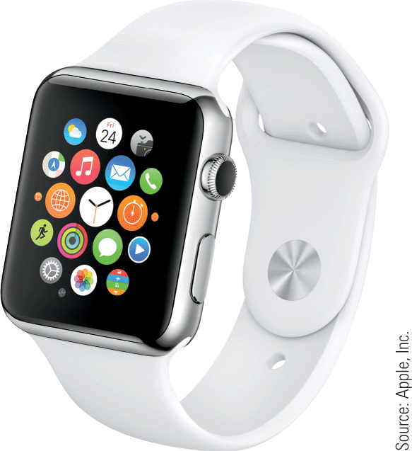
Trend
Apple Watch
Designed to work in conjunction with an iPhone for much of its functionality
Launch apps and select options via touch
Also supports voice input
Apple Pay enables you to make payments via a store’s contactless payment terminal
Apple Watch

Slide 40
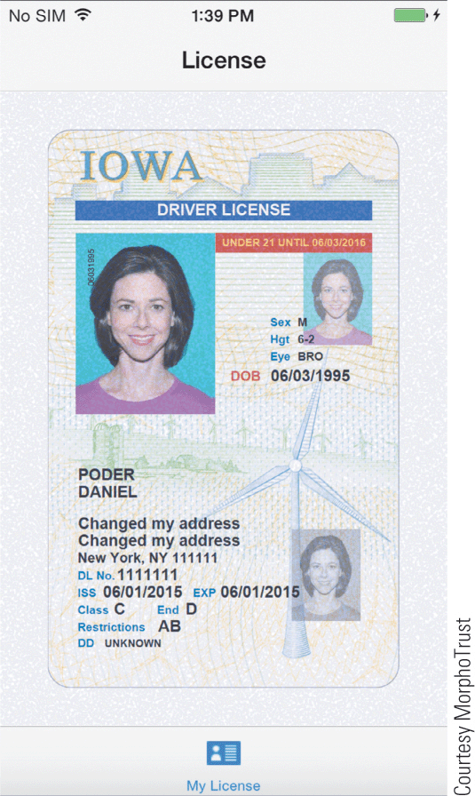
Inside the Industry
Smartphone Driver Licenses
Several states are currently testing, and likely implementing, digital driver licenses (DDLs)
DDLs resemble your paper driver license, and contain the same information
DDLs are mobile apps that can contain additional features
Some issues need to be resolved before widespread use
A smartphone driver license.

Slide 41
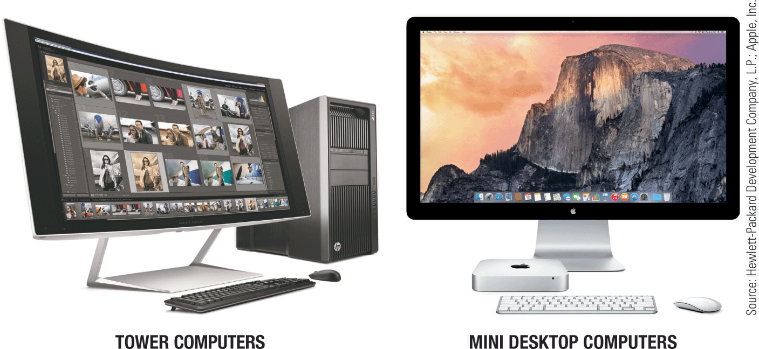
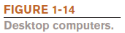
Personal Computers (PCs)
A personal computer (PC) is a small computer designed to be used by one person at a time
Originally called a microcomputer
Available in different sizes and shapes
Desktop computers
Sit on or next to a desk
Tower case, desktop case, or all-in-one
PC or Macintosh
Not portable

Slide 42
Portable Computers
A portable computer is designed to be carried around easily
Notebook (laptop) computers
Typically use a clamshell design
Tablet computers
Usually use a digital pen/stylus or touch screen
No physical keyboard; on-screen or attached keyboard
Hybrid notebook-tablet computers
Can function as either a notebook or a tablet
Netbooks
Smaller; designed for accessing Internet resources

Slide 43
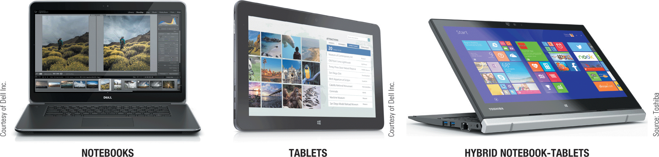
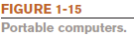
Examples of Portable Computers

Slide 44
Thin Client and Internet Appliances
A thin client is designed to utilize a network for much of its processing
Advantages include lower cost, increased security, and easier maintenance
Disadvantages include limited or no local storage and the inability to function if the network is down
An Internet appliance is an ordinary device that can be used for accessing the Internet
Some use apps to deliver news, sports scores, weather, music, and other Web-based information
Include smart TVs, refrigerators, and other appliances

Slide 45
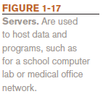
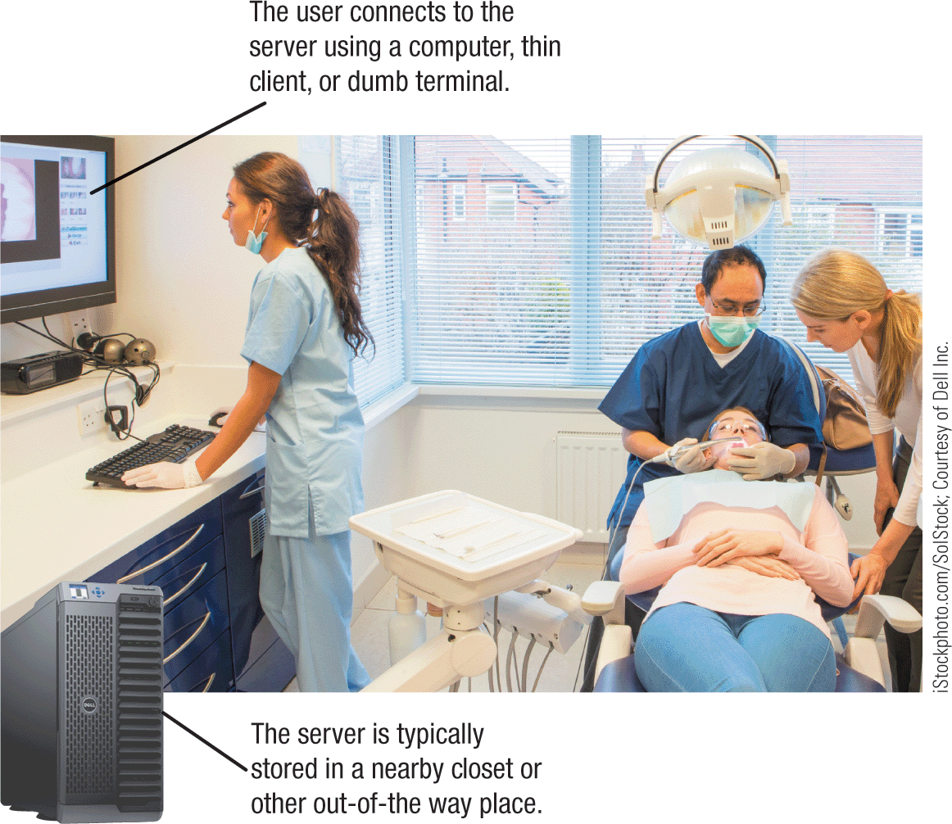
Servers
A server is a midrange computer used to host programs and data for a small network
Users connect via a network with a computer, thin client, or dumb terminal
Virtualization refers to creating virtual rather than actual server environments
Used to share a server for increased efficiency
Desktop virtualization delivers a user’s desktop to his or her current device

Slide 46
Mainframe Computers
A mainframe computer is a powerful computer used by many large organizations to manage large amounts of centralized data
Often used in hospitals, universities, large businesses, banks, government offices, etc.
Located in climate-controlled data centers and connected to the rest of the company computers via a network
Runs programs to meet the needs of a wide variety of users, as well as large processing tasks during off hours
Often uses virtualization; used for new and emerging needs such as processing data from smart meters and running social networks
Also called high-end servers or enterprise-class servers

Slide 47
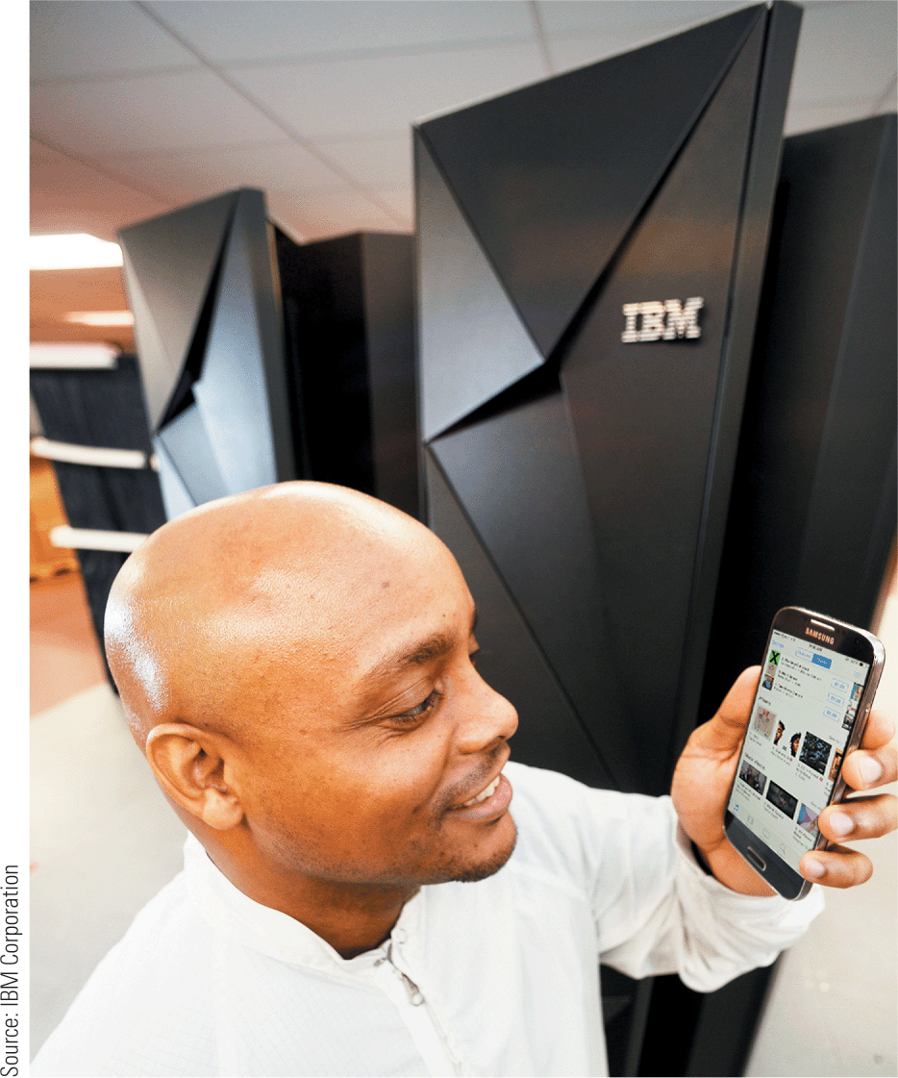
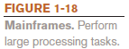
Example of a Mainframe Computer

Slide 48
Supercomputers
A supercomputer is the fastest, most expensive, most powerful type of computer
Generally run one program at a time, as fast as possible
New applications include hosting extremely complex Web sites and three-dimensional applications
Can cost several million dollars each
Tend to be very large and contain a large number of processors
Example: Titan is one of the fastest computers in the world
Contains more than 300,000 processors
Peak speed is 27,000 calculations per second

Slide 49
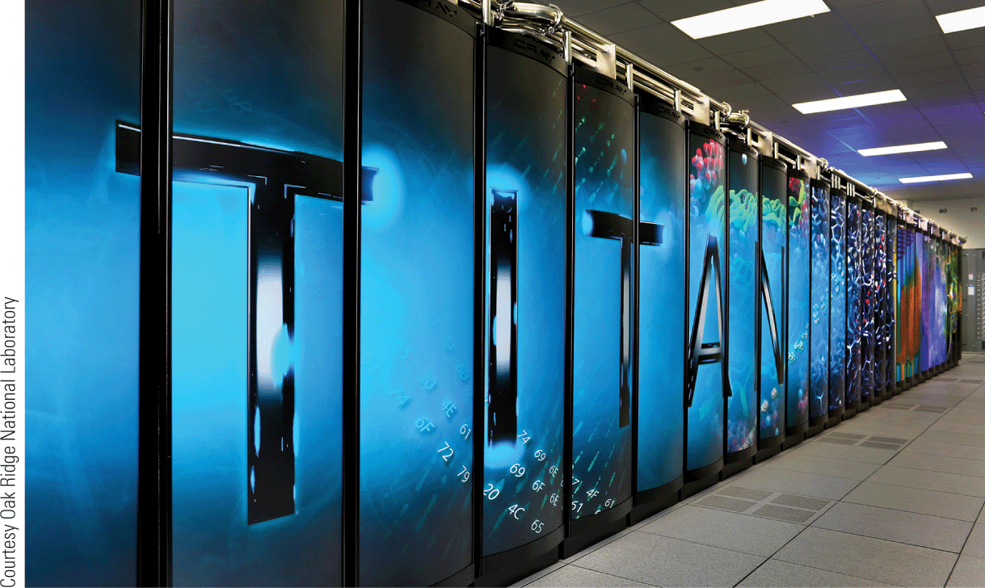
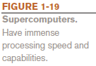
Example of a Supercomputer

Slide 50
Quick Quiz (2)
1. A tablet computer is an example of a(n) _____________.
a. desktop computer
b. portable computer
c. Internet appliance
2. True or False: The terms mainframe computer and supercomputer are interchangeable; both refer to the largest, most powerful computers.
3. A smartphone is an example of a(n) _____________.

Slide 51
Quick Quiz (2)
Answers:
b;
2) False;
3) mobile device

Slide 52
Computer Networks and the Internet
A computer network is a collection of hardware and other devices that are connected together
Users can share hardware, software, and data
Users can communicate with each other
Users can share an Internet connection
Most computers and mobile devices today connect to a computer network
Examples include small and large business networks, school networks, home networks, public wireless networks, and mobile telephone networks

Slide 53
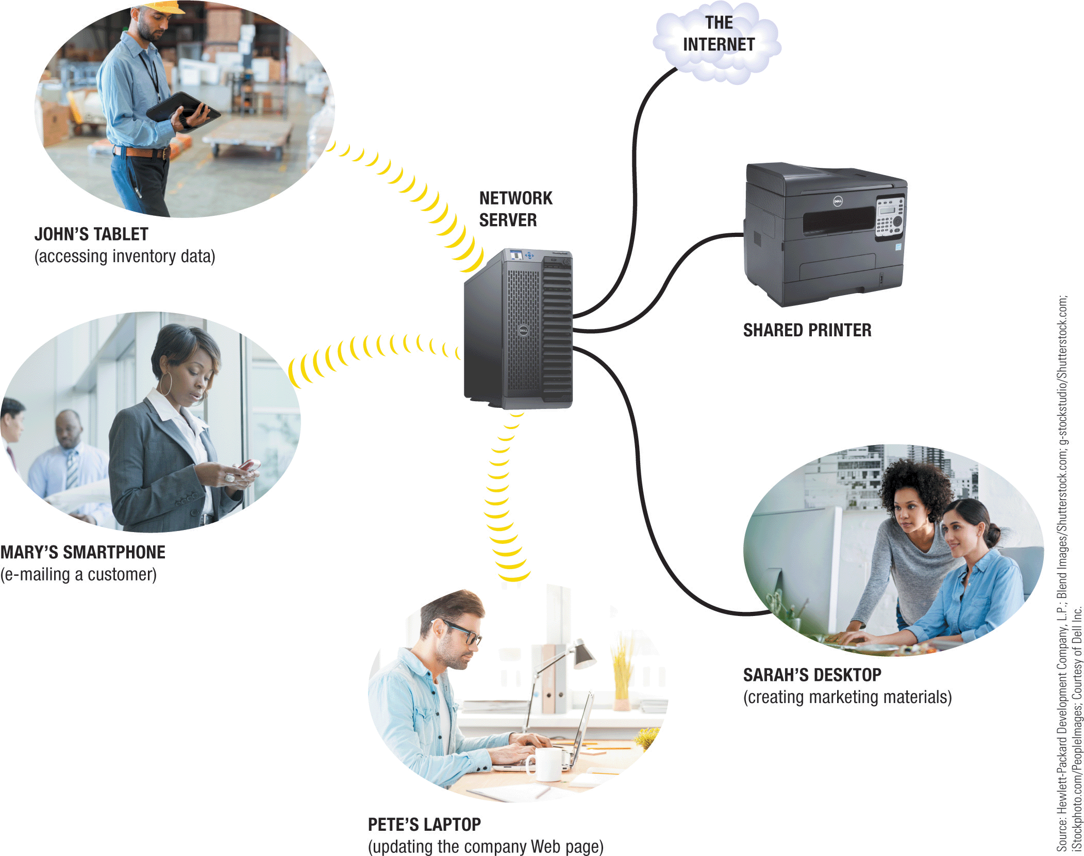
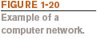
Example of a Computer Network

Slide 54
What Are the Internet and the World Wide Web?
The Internet is the largest/most well-known computer network in the world
Individuals connect using an Internet service provider (ISP)
ISPs connect to regional networks, which connect to backbone networks, which connect to form the Internet
The World Wide Web (Web) is one resource (a vast collection of Web pages) available through the Internet
Web pages typically contain hyperlinks
Web sites contain Web pages stored on Web servers
Web pages are viewed using a Web browser (Edge, Internet Explorer (IE), Chrome, Safari, Firefox, Opera, etc.)
Web pages offer a wide variety of information and uses

Slide 55
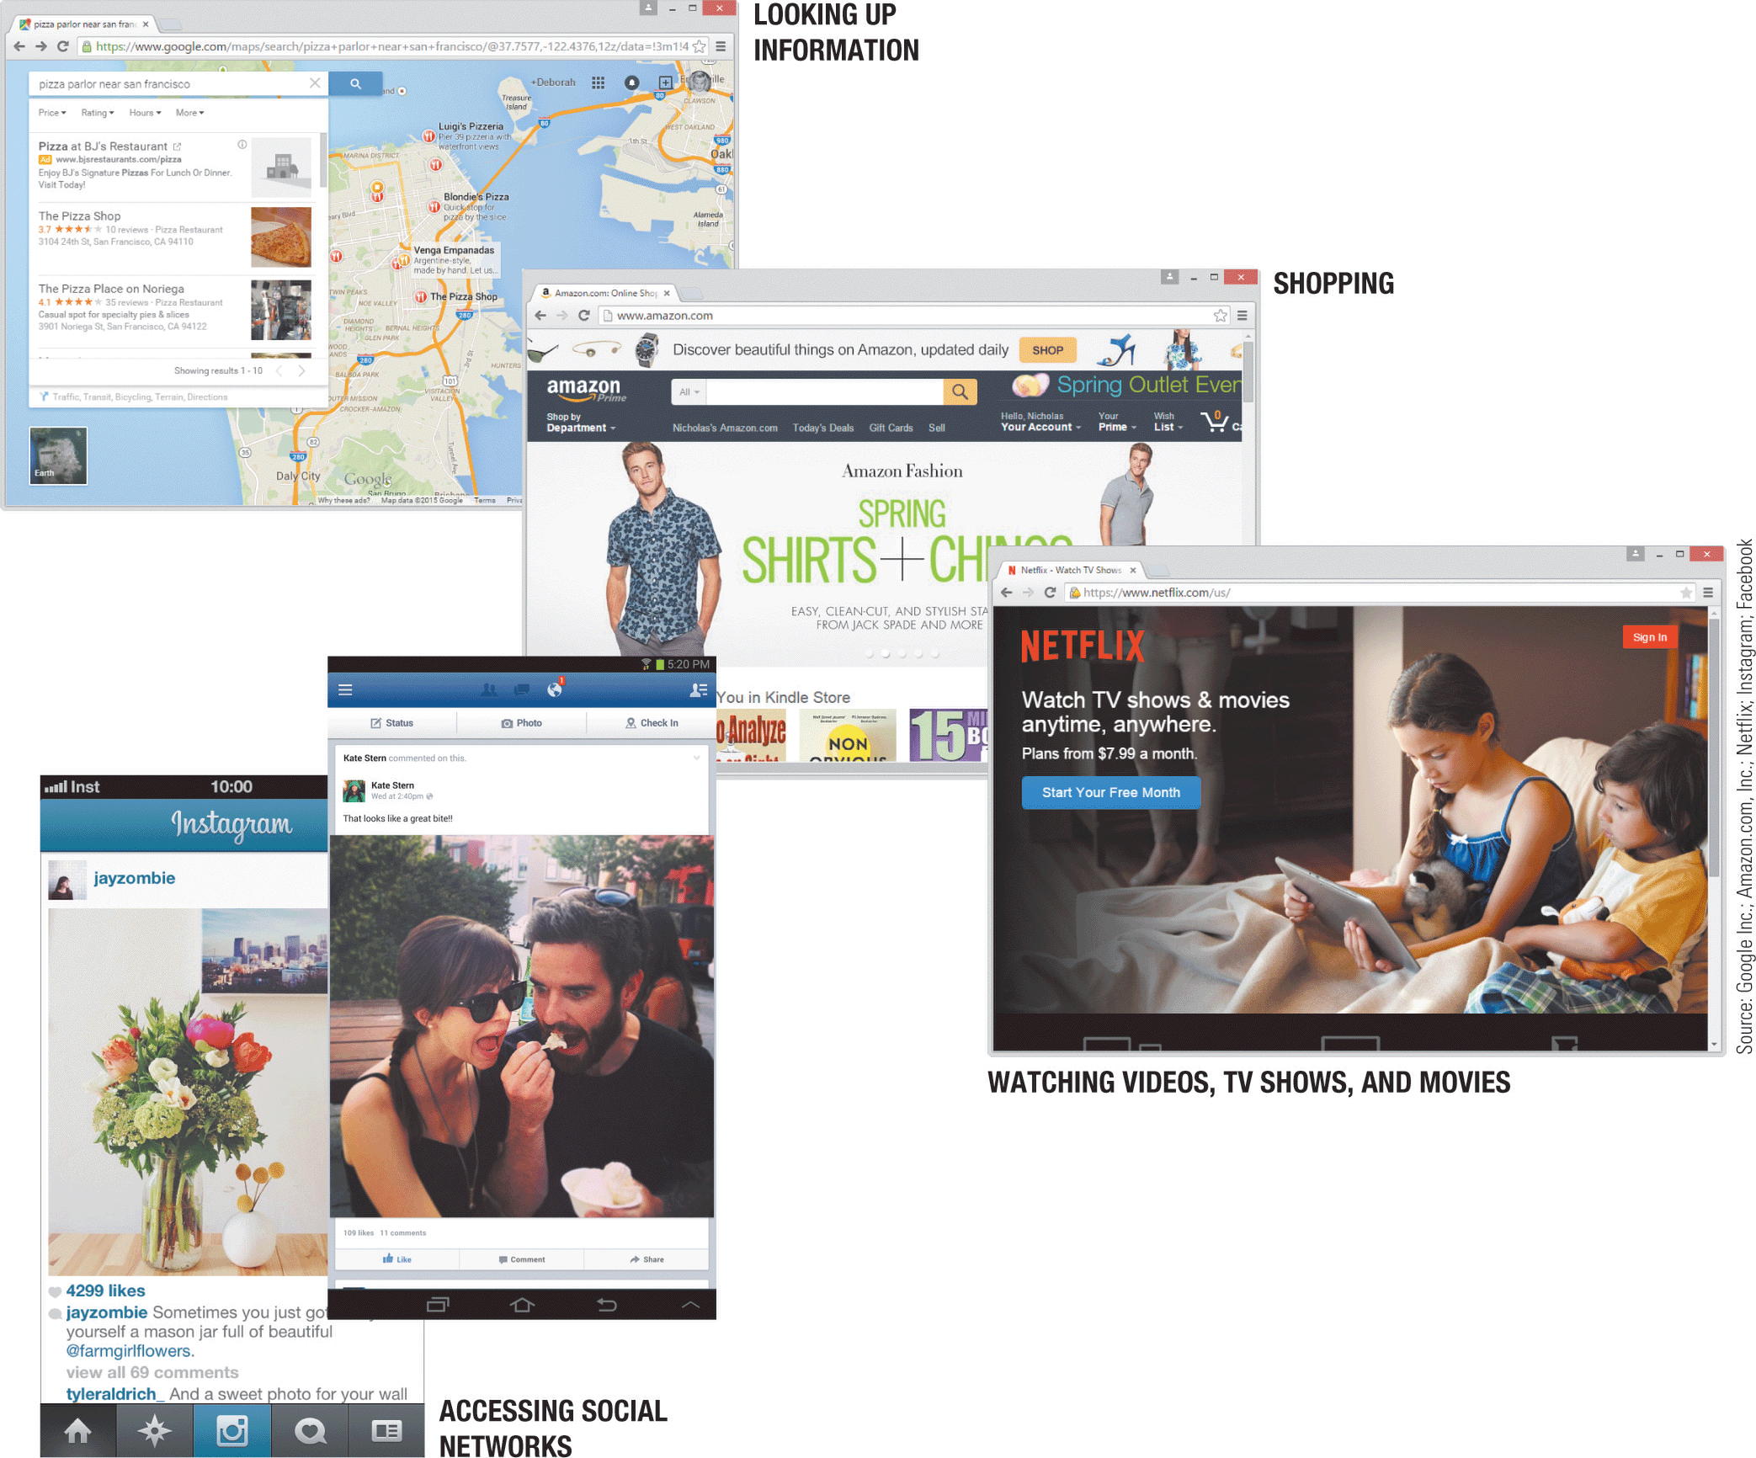
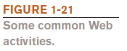
Examples of Common Web Activities

Slide 56
Accessing a Network or the Internet
Need a network adapter to connect
Many networks require a username and password
Internet connections can be:
Direct (always-on) connections
Dial-up connections
Internet addresses access resources on the Internet
The most common types of Internet addresses:
IP addresses and domain names (to identify computers)
Uniform Resource Locator (URL) identifies Web pages
E-mail addresses (username) identifies person)

Slide 57
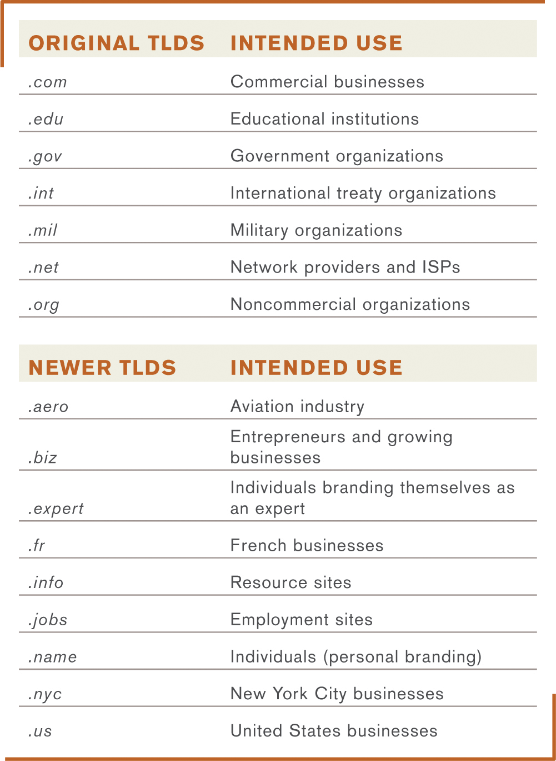
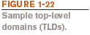
IP Addresses and Domain Names
An IP (Internet Protocol) address is a numeric address that identifies computers (such as 134.170.185.46)
A domain name is a name (such as microsoft.com) that corresponds to an IP address
The top-level domain (TLD) is the far right part of the name and identifies the type of the organization or its location

Slide 58
Uniform Resource Locators (URLs)
A Uniform Resource Locator (URL) uniquely identifies a Web page
It indicates:
The protocol or standard being used, such as:
http:// for Web pages
https:// for secure Web pages
ftp:// for some file transfers
The Web server hosting the page
The names of the folders in which the Web page file is stored
The Web page’s filename

Slide 59
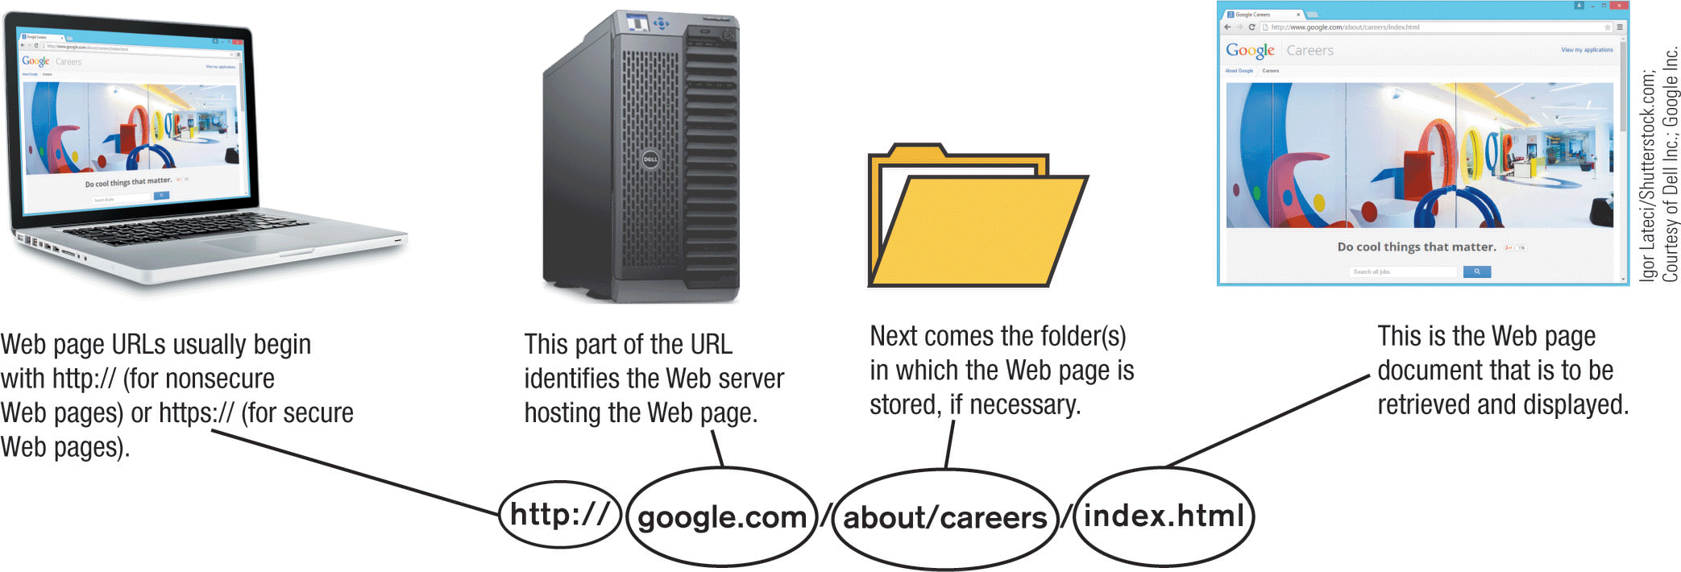
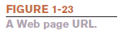
Example of a Web Page URL

Slide 60
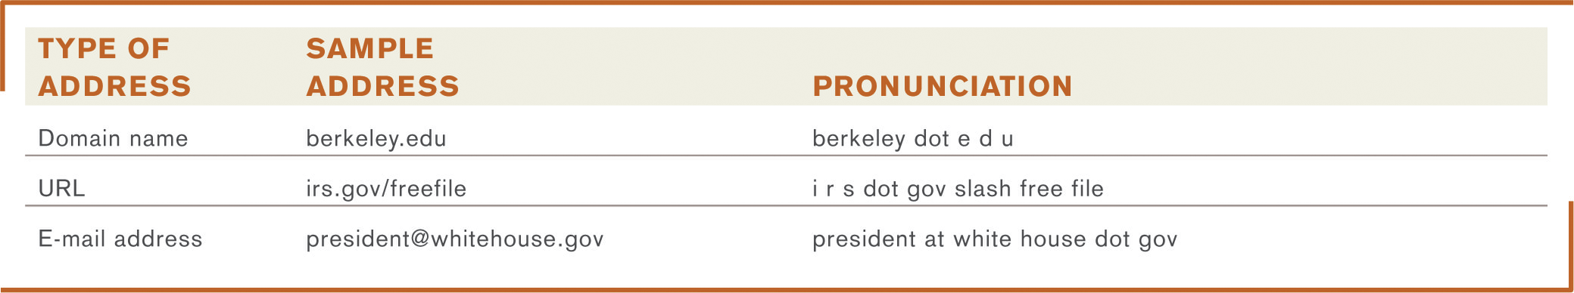
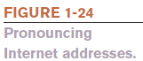
E-Mail Addresses
An e-mail address consists of:
A username
An identifying name (unique within a domain name)
The @ symbol
The domain name for the computer that will be handling the person’s e-mail (mail server)
Pronouncing Internet addresses

Slide 61
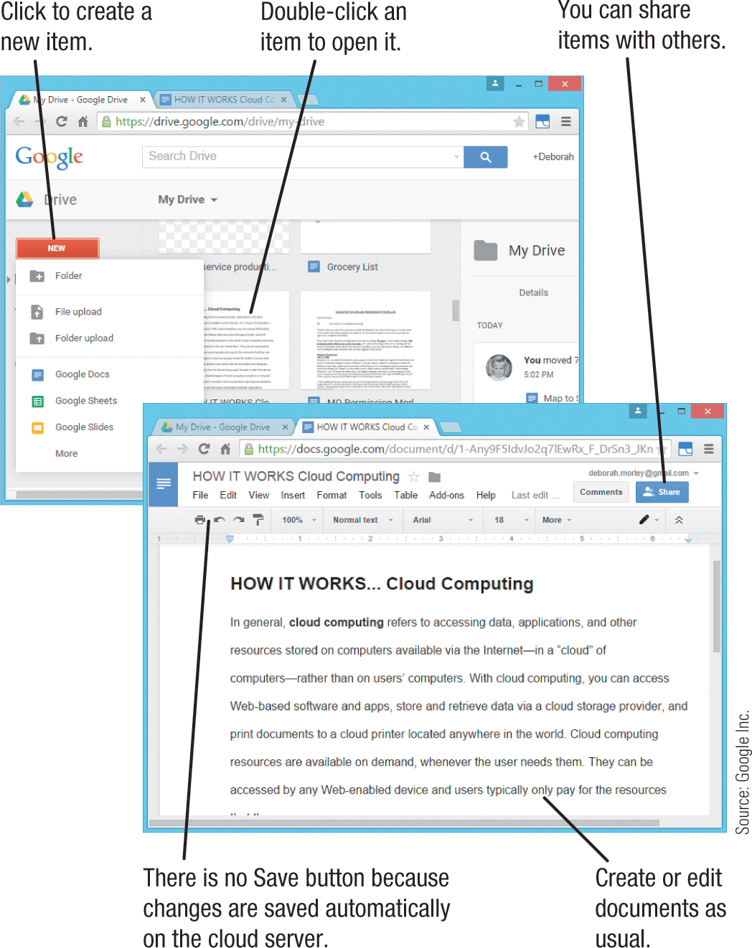
How It Works
Cloud Computing
Resources stored on computers in a “cloud” of computers rather than on users’ computers
Resources are available on demand, accessible to any Web-enabled device
Cloud data is safe if the device is lost, stolen, or damaged
Google Docs and Google Drive are shown here
Google Drive and Docs.

Slide 62
Surfing the Web
A Web browser is used to display Web pages
The browser’s starting page or home page is the first page displayed when the browser is opened
Users can change their browser’s home page
From the home page, other Web pages can be accessed
To view a Web page:
Type a URL in the Address bar
Click a hyperlink (graphics or text linked to other Web pages) located on a Web page
Choose a Web page saved as a Favorite/bookmark or a Web page from the History List

Slide 63
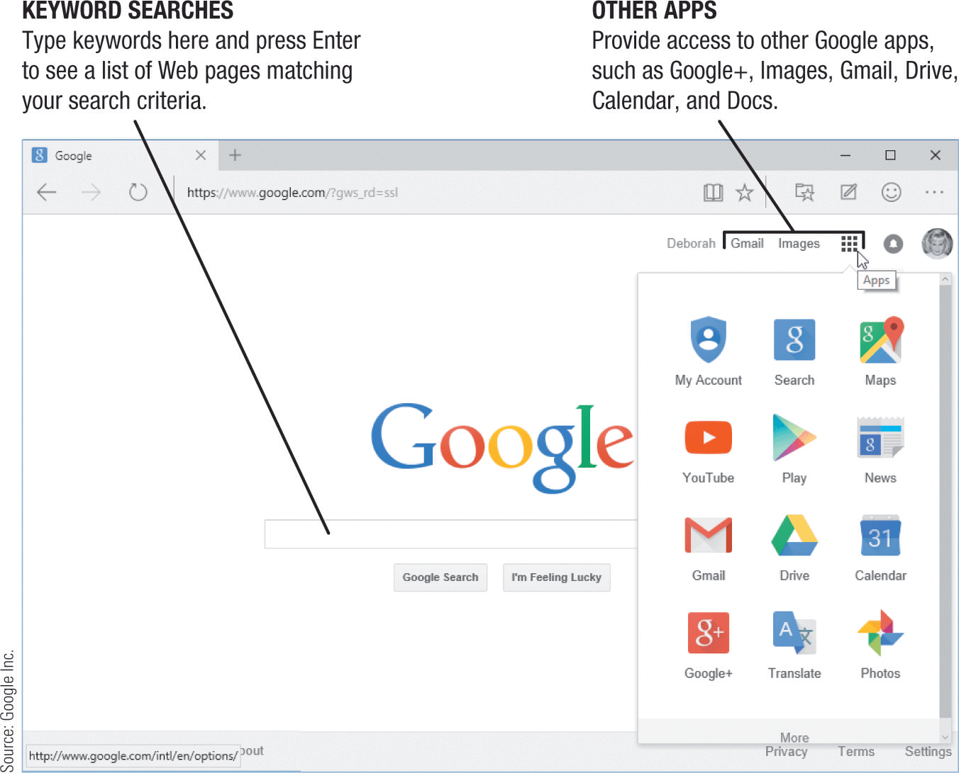
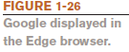
Searching the Web
A search site is a Web page that help you locate Web pages and other resources
Typically search using keywords
Reference sites are designed to let you look up addresses, telephone numbers, ZIP codes, maps, and other reference information
You can find reference sites using a search site

Slide 64
E-Mail
Electronic mail (e-mail) is the process of exchanging electronic messages between individuals over a network
One of the most widely used Internet applications
Can be sent and received via an installed e-mail program, or a Web mail service or app
Conventional Web-Based
Microsoft Outlook Gmail
OS X Mail Outlook.com
Can contain photos and other attached files
Mobile e-mail may be charged against data usage
Other types of mobile communications include text messages and multimedia messages

Slide 65
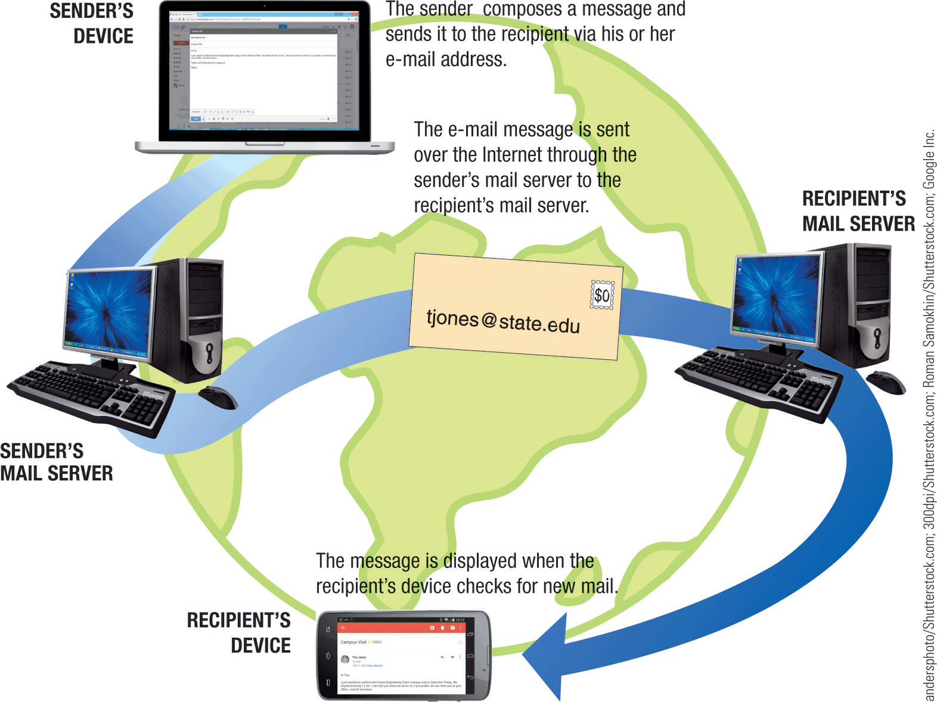
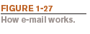
How E-Mail Works

Slide 66
Technology and Society: Benefits
The vast improvements in technology over the past decade have had a distinct impact on daily life, at home, and at work
Benefits of a technology-oriented society include:
Design before construction leads to safer products
Earlier medical diagnoses and more effective treatment
Devices that allow physically and/or visually challenged individuals to perform job tasks
Documents e-mailed or faxed in moments
Download information, music, movies, and more on demand

Slide 67
Technology and Society: Risks
Risks of a technology-oriented society include:
Stress and health concerns
Security issues
Computer viruses and malware
Identity theft and phishing
Privacy issues
Spam
How collected data is used
How secure the collected data is

Slide 68
Technology and Society: Online Communications
Differences in online communications
Less formal than traditional communications
Netiquette
Be polite and considerate of others
Refrain from offensive remarks
Abbreviations (acronyms) and emoticons are often used
Acronyms, such as BTW (by the way)
Emoticons (typically illustrations of faces), such as ☺

Slide 69
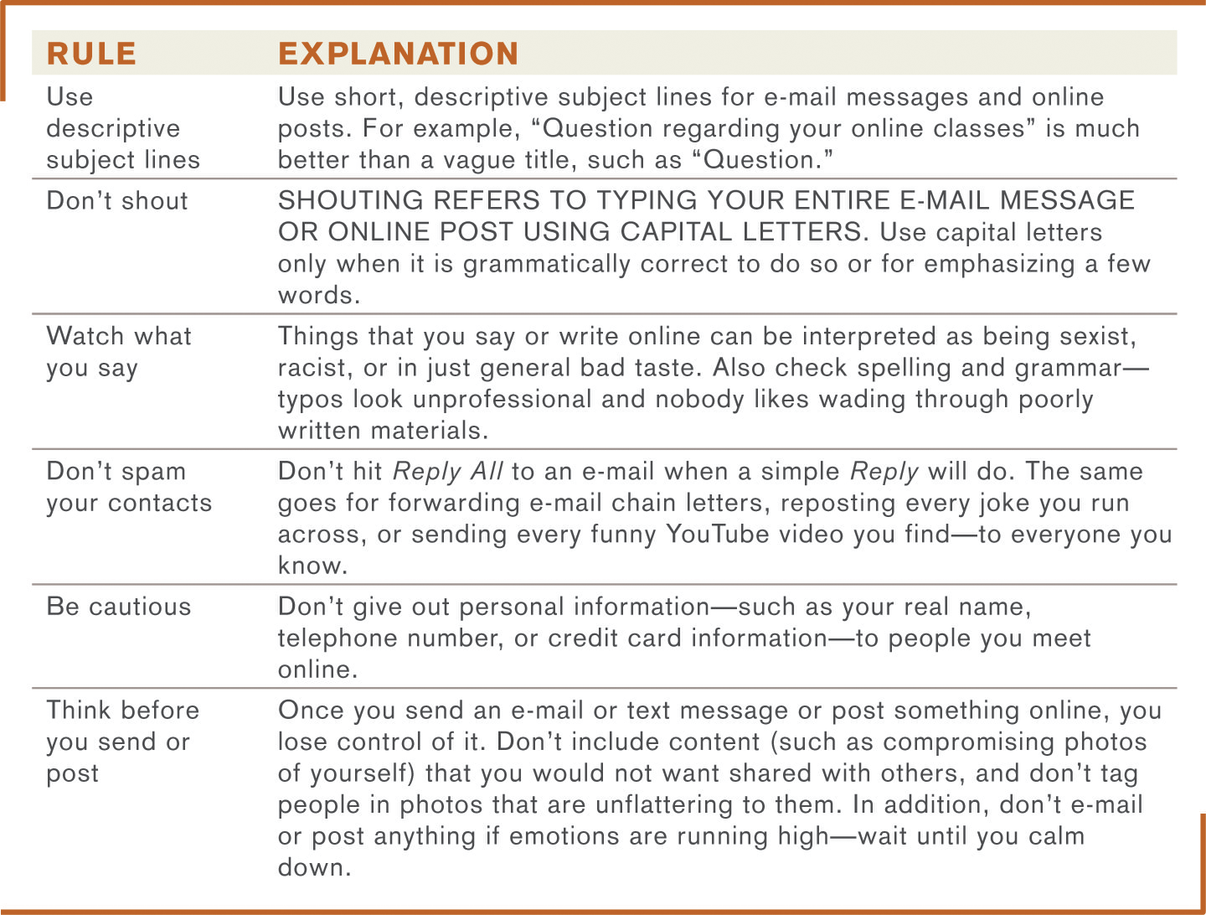

Technology and Society: Netiquette

Slide 70
Technology and Society: Anonymity and Integrity
The anonymity factor
Online communications can be anonymous
Anonymity gives many individuals a sense of freedom
Online anonymity can also be abused
Information integrity
Use common sense when evaluating online content
Check your sources—not all information on the Internet is accurate
Double-check information before using it or passing it on to others

Slide 71
Quick Quiz (3)
1. Index.html is an example of a(n) _____________.
a. URL
b. IP address
c. Web page filename
2. True or False: All information published to Web pages is accurate.
3. In the e-mail address jsmith@abc.com, abc.com is the _____________.

Slide 72
Quick Quiz (3)
Answers:
c;
False;
domain name

Slide 73
Summary
Technology in Your Life
What is a Computer and What Does It Do?
Computers to Fit Every Need
Computer Networks and the Internet
Technology and Society

Slide 74
In-class Discussion
Select a technology you use every day and consider its benefits and risks. Answer the following questions:
What benefits does the technology provide?
Are there any risks involved, and if so, how can they be minimized?
If you chose not to use this technology because of the possible risks associated with it, how would your life affected?
Who should determine if the benefits of a new technology outweigh the potential risks? Consumers? Companies? The government?

